Slide 1
IE251: Probability for Engineers
Problem Session
December 27th

Slide 2
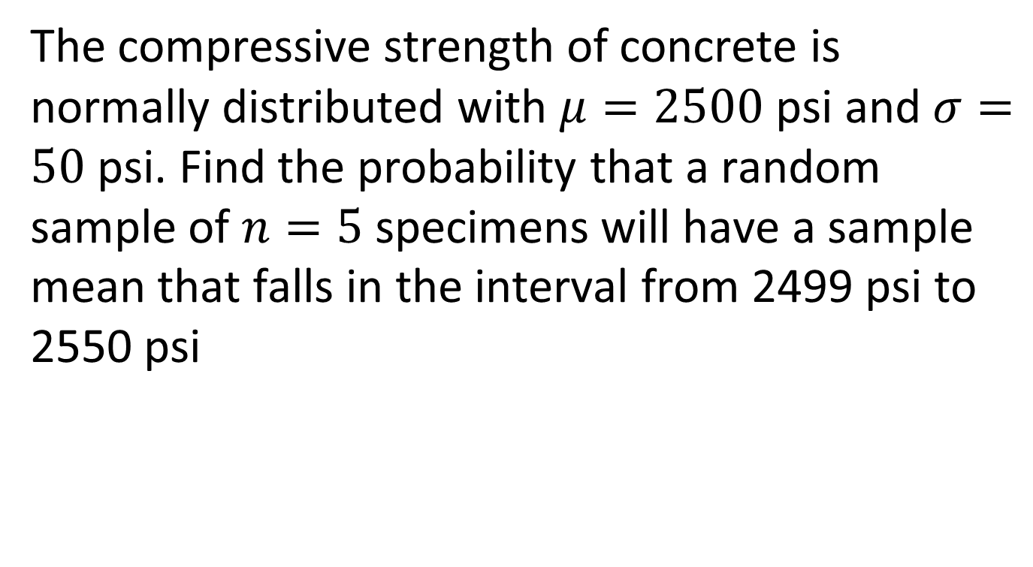
Problem 1
The compressive strength of concrete is normally distributed with $μ=2500$ psi and$σ=50$ psi. Find the probability that a random sample of $n=5$ specimens will have a sample mean that falls in the interval from 2499 psi to 2550 psi

Slide 3
Problem 2
A normal population has mean 100 and variance 25. How large must the random sample be if we want the standard error of the sample average to be 1.5?

Slide 4
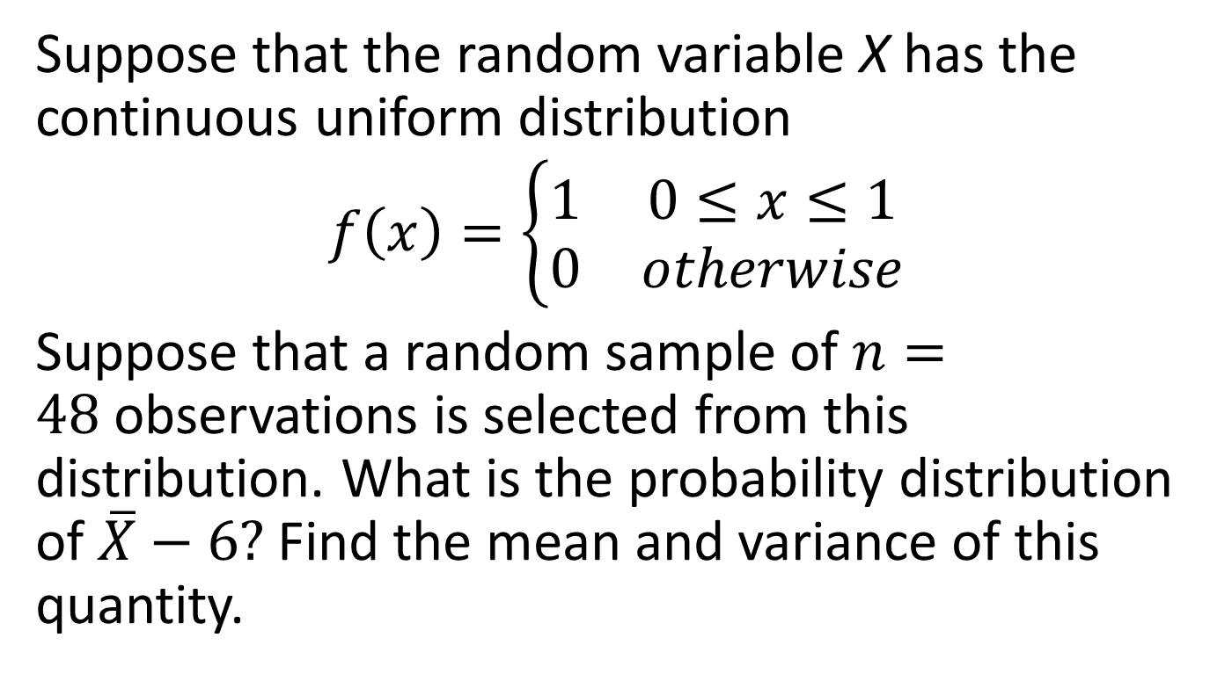
Problem 3
Suppose that the random variable X has the continuous uniform distribution
$$f\left(x\right)=\left\{\begin{matrix}1 & 0≤x≤1 \\ 0 & otherwise\end{matrix}\right.$$
Suppose that a random sample of $n=48$observations is selected from this distribution. What is the probability distribution of $\overline{X}−6?$ Find the mean and variance of this quantity.

Slide 5
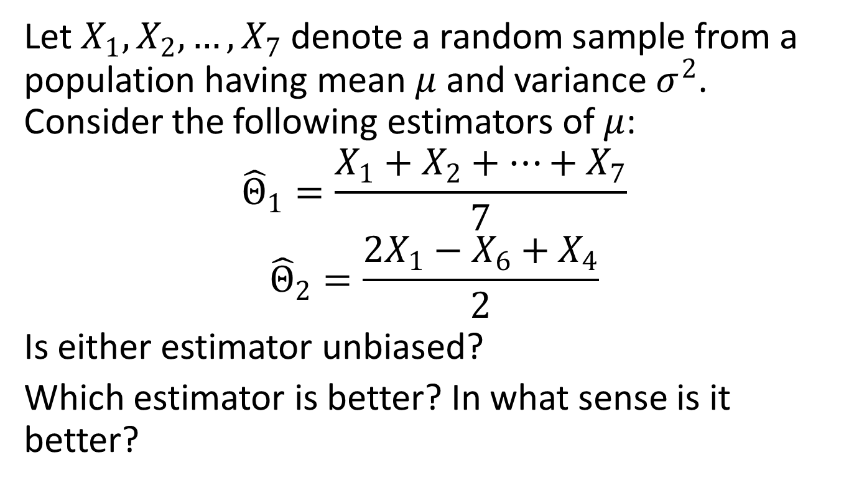
Problem 4
Let $X_{1},X_{2},…, X_{7}$ denote a random sample from a population having mean $μ$ and variance $σ^{2}$. Consider the following estimators of $μ$:
$${\hat{Θ}}_{1}=\frac{X_{1}+X_{2}+…+X_{7}}{7}$$
$${\hat{Θ}}_{2}=\frac{2X_{1}−X_{6}+X_{4}}{2}$$
Is either estimator unbiased?
Which estimator is better? In what sense is it better?

Slide 6
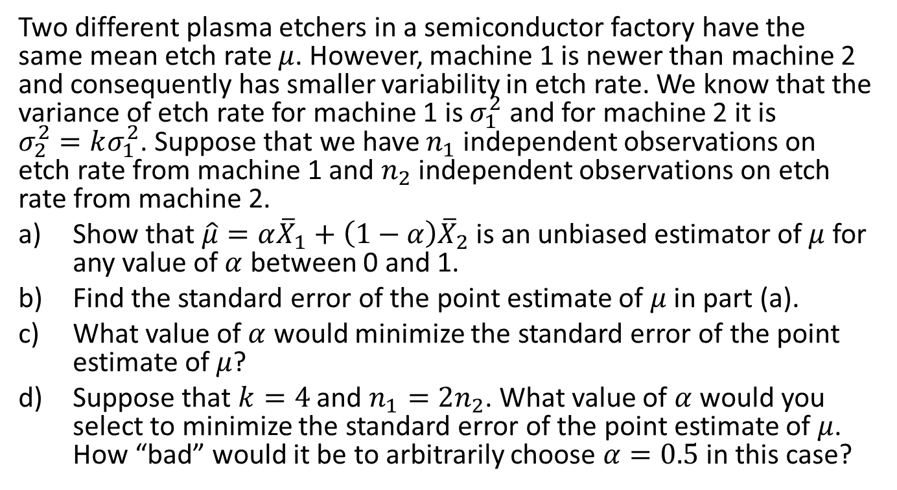
Problem 5
Two different plasma etchers in a semiconductor factory have the same mean etch rate $μ$. However, machine 1 is newer than machine 2 and consequently has smaller variability in etch rate. We know that the variance of etch rate for machine 1 is $σ_{1}^{2}$ and for machine 2 it is $σ_{2}^{2}=kσ_{1}^{2}$. Suppose that we have $n_{1}$independent observations on etch rate from machine 1 and $n_{2}$ independent observations on etch rate from machine 2.
Show that $\hat{μ}=α{\overline{X}}_{1}+\left(1−α\right){\overline{X}}_{2}$ is an unbiased estimator of $μ$for any value of $α$ between 0 and 1.
Find the standard error of the point estimate of $μ$ in part (a).
What value of $α$ would minimize the standard error of the point estimate of $μ$?
Suppose that $k=4$ and $n_{1}=2n_{2}$. What value of $α$ would you select to minimize the standard error of the point estimate of $μ$. How “bad” would it be to arbitrarily choose $α=0.5$ in this case?

Slide 7

Problem 6
Consider the Poisson distribution
$$f\left(x\right)=\frac{e^{−λ}λ^{x}}{x!}$$
Find the maximum likelihood estimator for $λ$.

